Slide 1
Review
COMP2014J: Data Structures and Algorithms 2
Dr. David Lillis (david.lillis@ucd.ie)
Beijing-Dublin International College

Slide 2
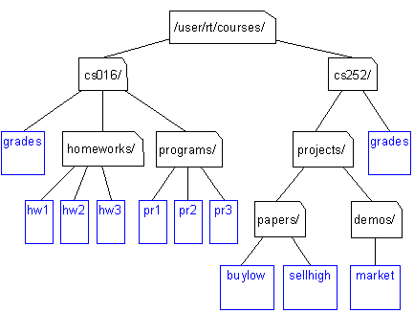
Trees
Hierarchical ADT where a node has at most 1 parent and has 0 or more children.
One node is the root.
Terminology (root/parent/internal/external/height/subtree/etc.)
Operations: root(), parent(n), children(n), isInternal(n), isExternal(n), etc.

Slide 3
Binary Tree
Binary Tree: Tree where each node has at most 2 children (left and right child)
Extra operations: left(n), right(n), hasLeft(n), hasRight(n)
Proper Binary Tree: Tree where each node has either 0 or 2 children (never 1)
Useful strategy: only internal nodes store data.
Link-based implementation
Extra operations:
expandExternal(n,e), remove(n)
Tree Traversals and the Visitor Pattern:
preorder, inorder, postorder traversal.
Why do we need 3 different ways?
Notes:
Preorder: tree copy
Inorder: visit BST in sorted order
Postorder: freeing memory, filesystem (not binary)

Slide 4
Binary Search Tree
Proper Binary Tree, plus:
Each internal node holds a value
According to some total order relation:
Left child (+ sub tree) stores values < the node's value
Right child (+ sub tree) stores values > the node's value
Extra operations:
insert(e), find(e), remove(e)
Performs best when tree is balanced. Why?

Slide 5
AVL Tree
Self-balancing Binary Search Tree
Height-balance property leads to expected O(log n) performance.
Trinode restructuring: used for unbalanced trees after an insertion/removal
Single rotation/double rotation
For removal, keep checking for balance through to the root.

Slide 6
Splay Tree
Type of Binary Search Tree that is balanced in the amortized sense.
After a find(), insert() or remove() operation, splay a node until it reaches the root of the tree.
Zig; Zig-Zig; Zig-Zag operations.
Worst case: O(n) but expected performance is O(log n) using amortized analysis.
Spread the cost across a number of operations to measure the overall performance of the algorithm.

Slide 7
Priority Queues & Heaps
Heap is a type of binary tree used to implement a priority queue ADT: highest-priority element is always the next to be removed.
NOT a binary search tree.
Operations: insert(k,e), min(), remove() etc.
Heap:
Order property and Structural Completeness Property
After inserting: upheap: O(log n)
After removing: downheap O(log n)
Implemented as a Complete Binary Tree
Array-based implementation is suitable for this type of tree because we know the structure.

Slide 8
Graphs
Terminology (vertex, edge, directed, undirected, adjacent, degree, etc.)
Properties
Operations: endVertices(e), opposite(v,e), areAdjacent(v,w), replace(v,x), replace(e,x), insertVertex(o), insertEdge(v,w,o) etc.
3 implementation strategies
Edge List
Adjacency List
Adjacency Matrix
Comparison of time complexity for: incident edges; adjacent vertices, inserting/removing vertex, inserting/removing edge.
Comparison of space complexity.
Notes:
Properties:1) Σv deg(v) = 2m
2) m ≤ n (n - 1)/2

Slide 9
Graph Algorithms
Depth-First Search (DFS):
Keep following a path until it can go no further, then backtrack.
2 parts:
Try to begin DFS for each vertex in the graph.
Perform a DFS for the connected component of a vertex.
Breadth-First Search (BFS):
Similar to DFS except that it explores all vertices on a particular level before moving to the next level.

Slide 10
Graph Algorithms
Shortest Path (Dijkstra's Algorithm)
For a weighted graph, find shortest path between two vertices (actually computes a shortest path tree from a starting vertex).
Cloud of vertices, with edge relaxation.
Minimum Spanning Trees:
Kruskal’s Algorithm:
Multiple clouds of vertices.
Priority queue to add shortest edges first (if they’re part of a MST)

Slide 11
Text Compression: Huffman Encoding
Generate a Huffman tree from a piece of text.
Based on joining binary trees together according to the frequency of its letters (using a heap-based priority queue).
Use a Huffman tree to encode some text.
Start at the root; 0 for left child; 1 for right child.
Use a Huffman tree to decode some encoded text.
Follow the path to an external node that stores a character.
Result: text compression, as the codes are shorter than standard encodings (e.g. UTF-8)

Slide 12
Exam Details
80% of final grade
Monday June 17th @ 15:25
2 hour exam
3 questions on the paper: answer any 2 (each question is worth 50%)

Slide 13
Exam Advice
The exam is for you to show me what you know.
I can't give you marks for things you don't write.
e.g. "Describe the characteristics of a Binary Search Tree".
If you write "A Binary Search Tree is a Proper Binary Tree that also has extra features ...", you should also tell me what a Proper Binary Tree is.
It is better to write too much than too little.
If you want more paper, just ask for it:
PLEASE, PLEASE, PLEASE, don't do what these students did....

Slide 14
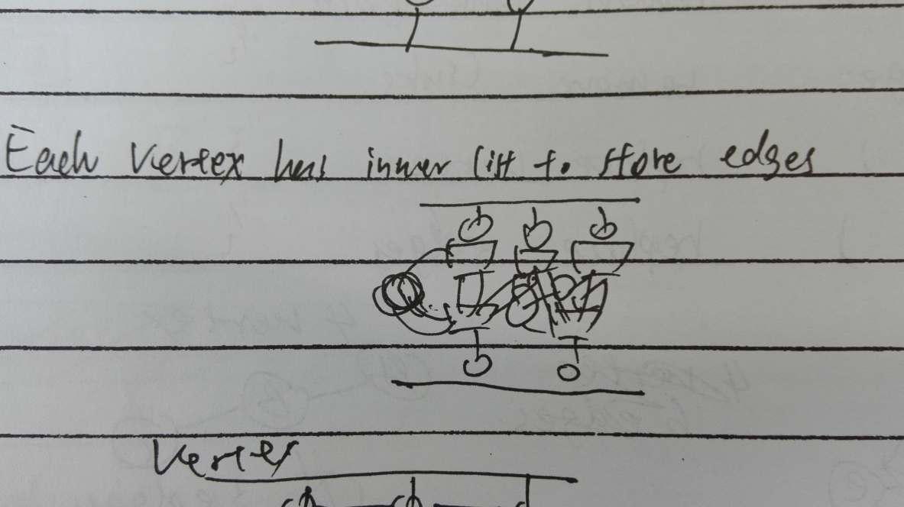

Slide 15
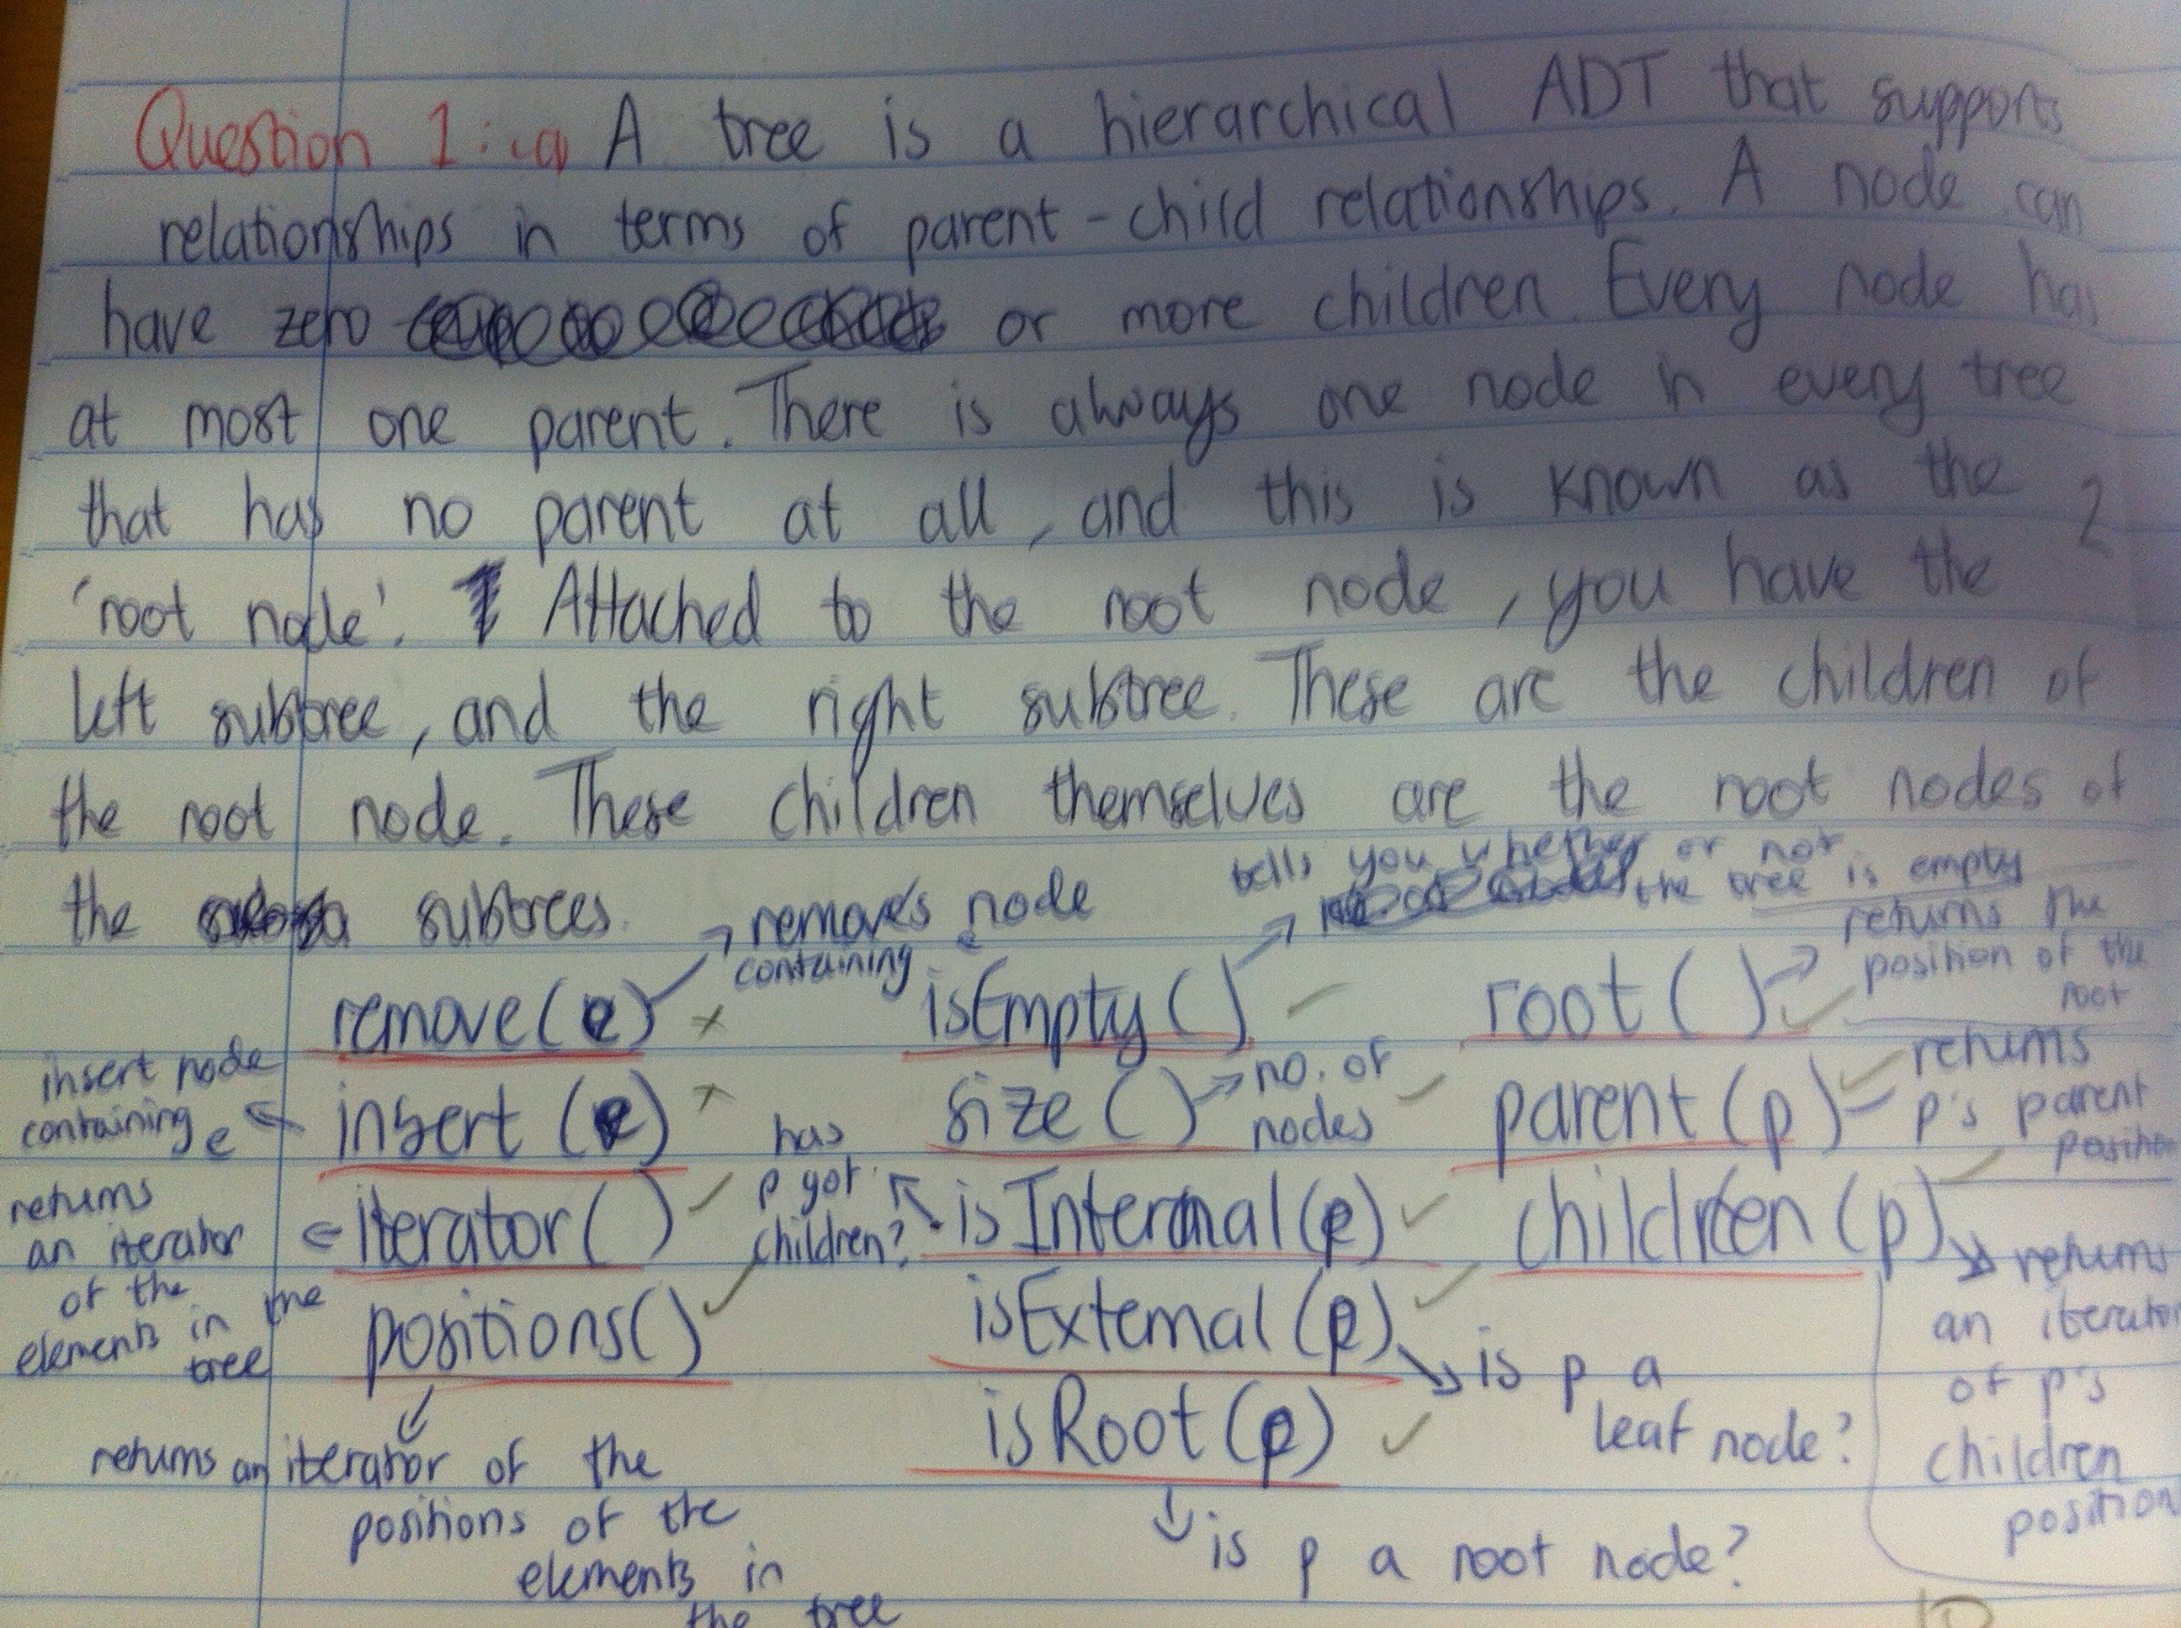

Slide 16
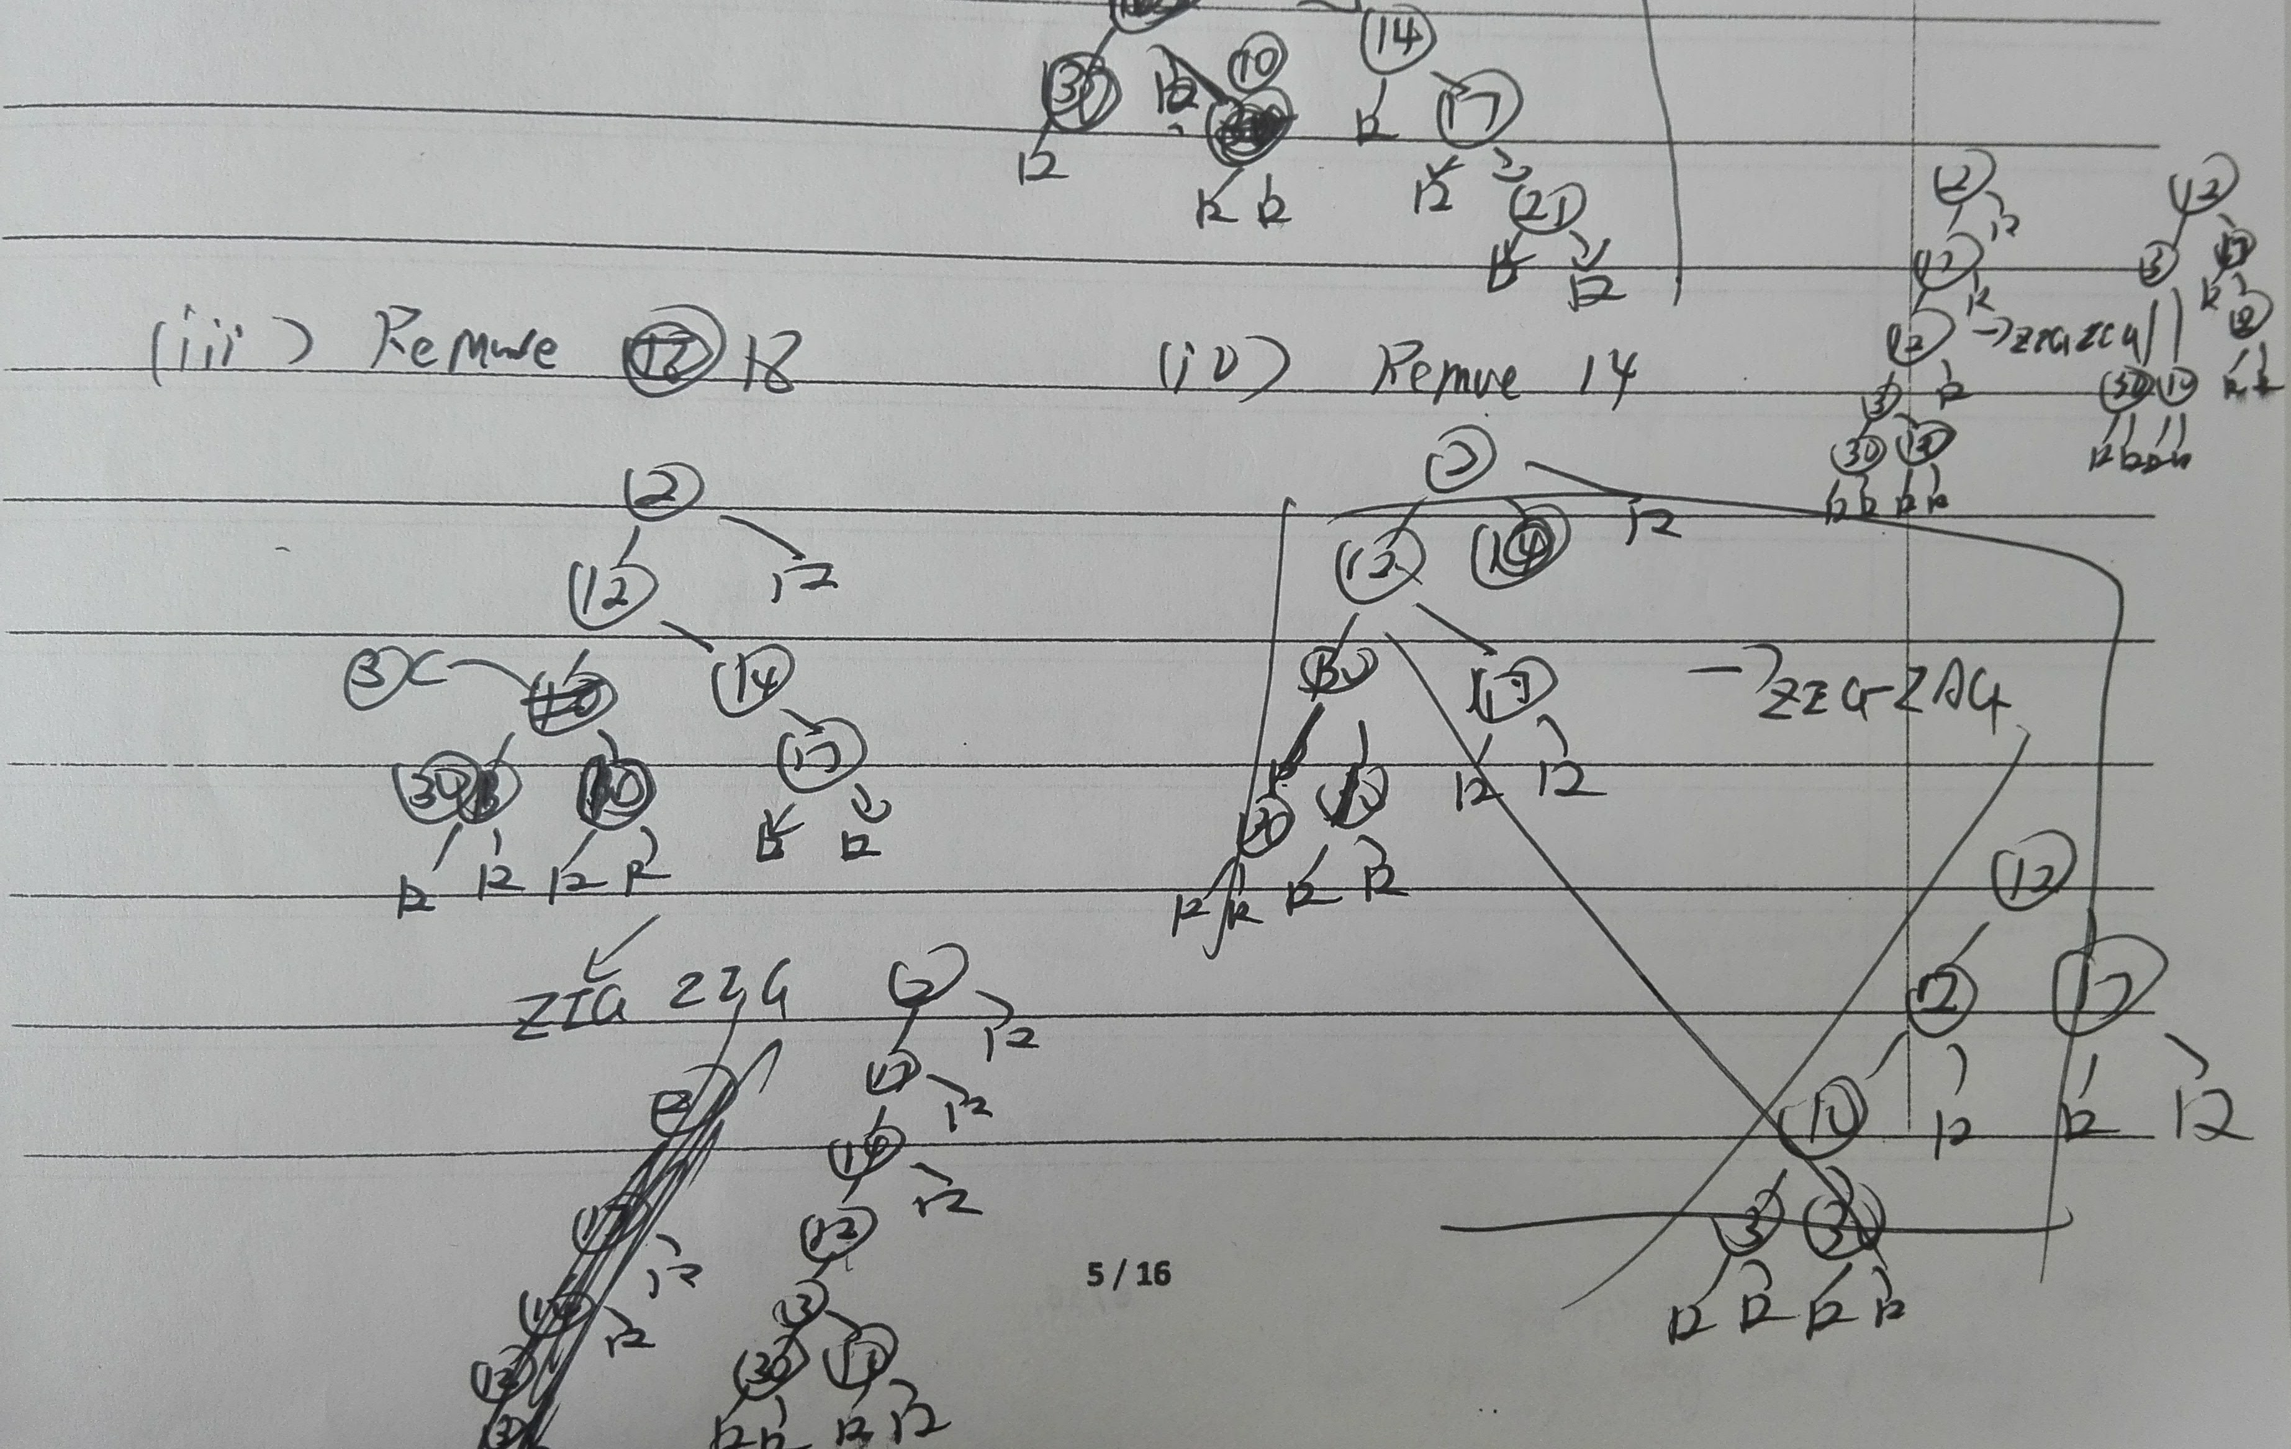

Slide 17
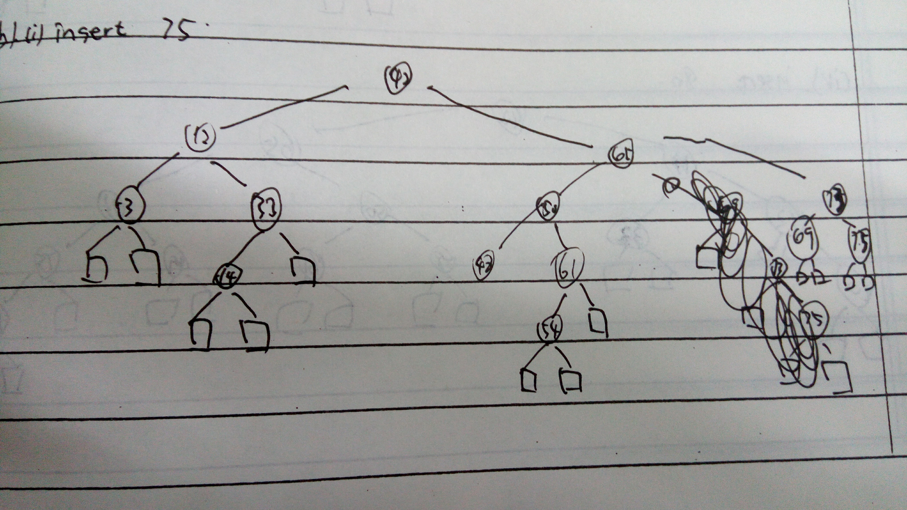

Slide 18
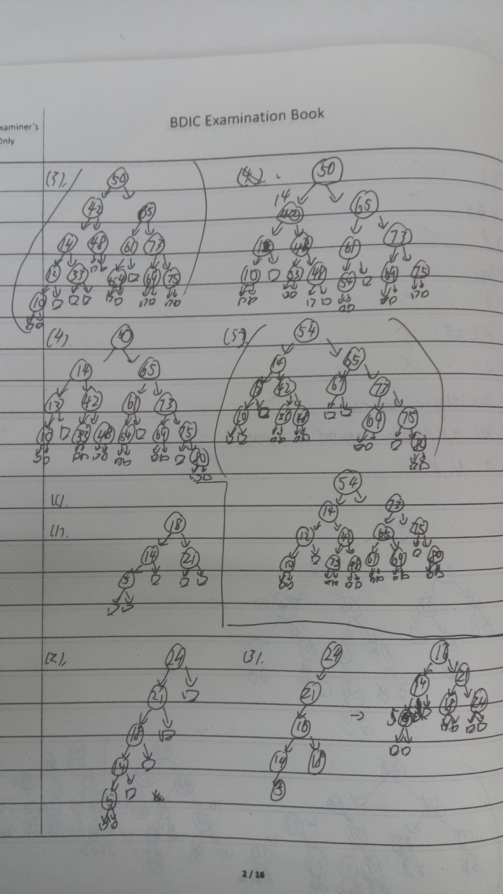

Slide 19
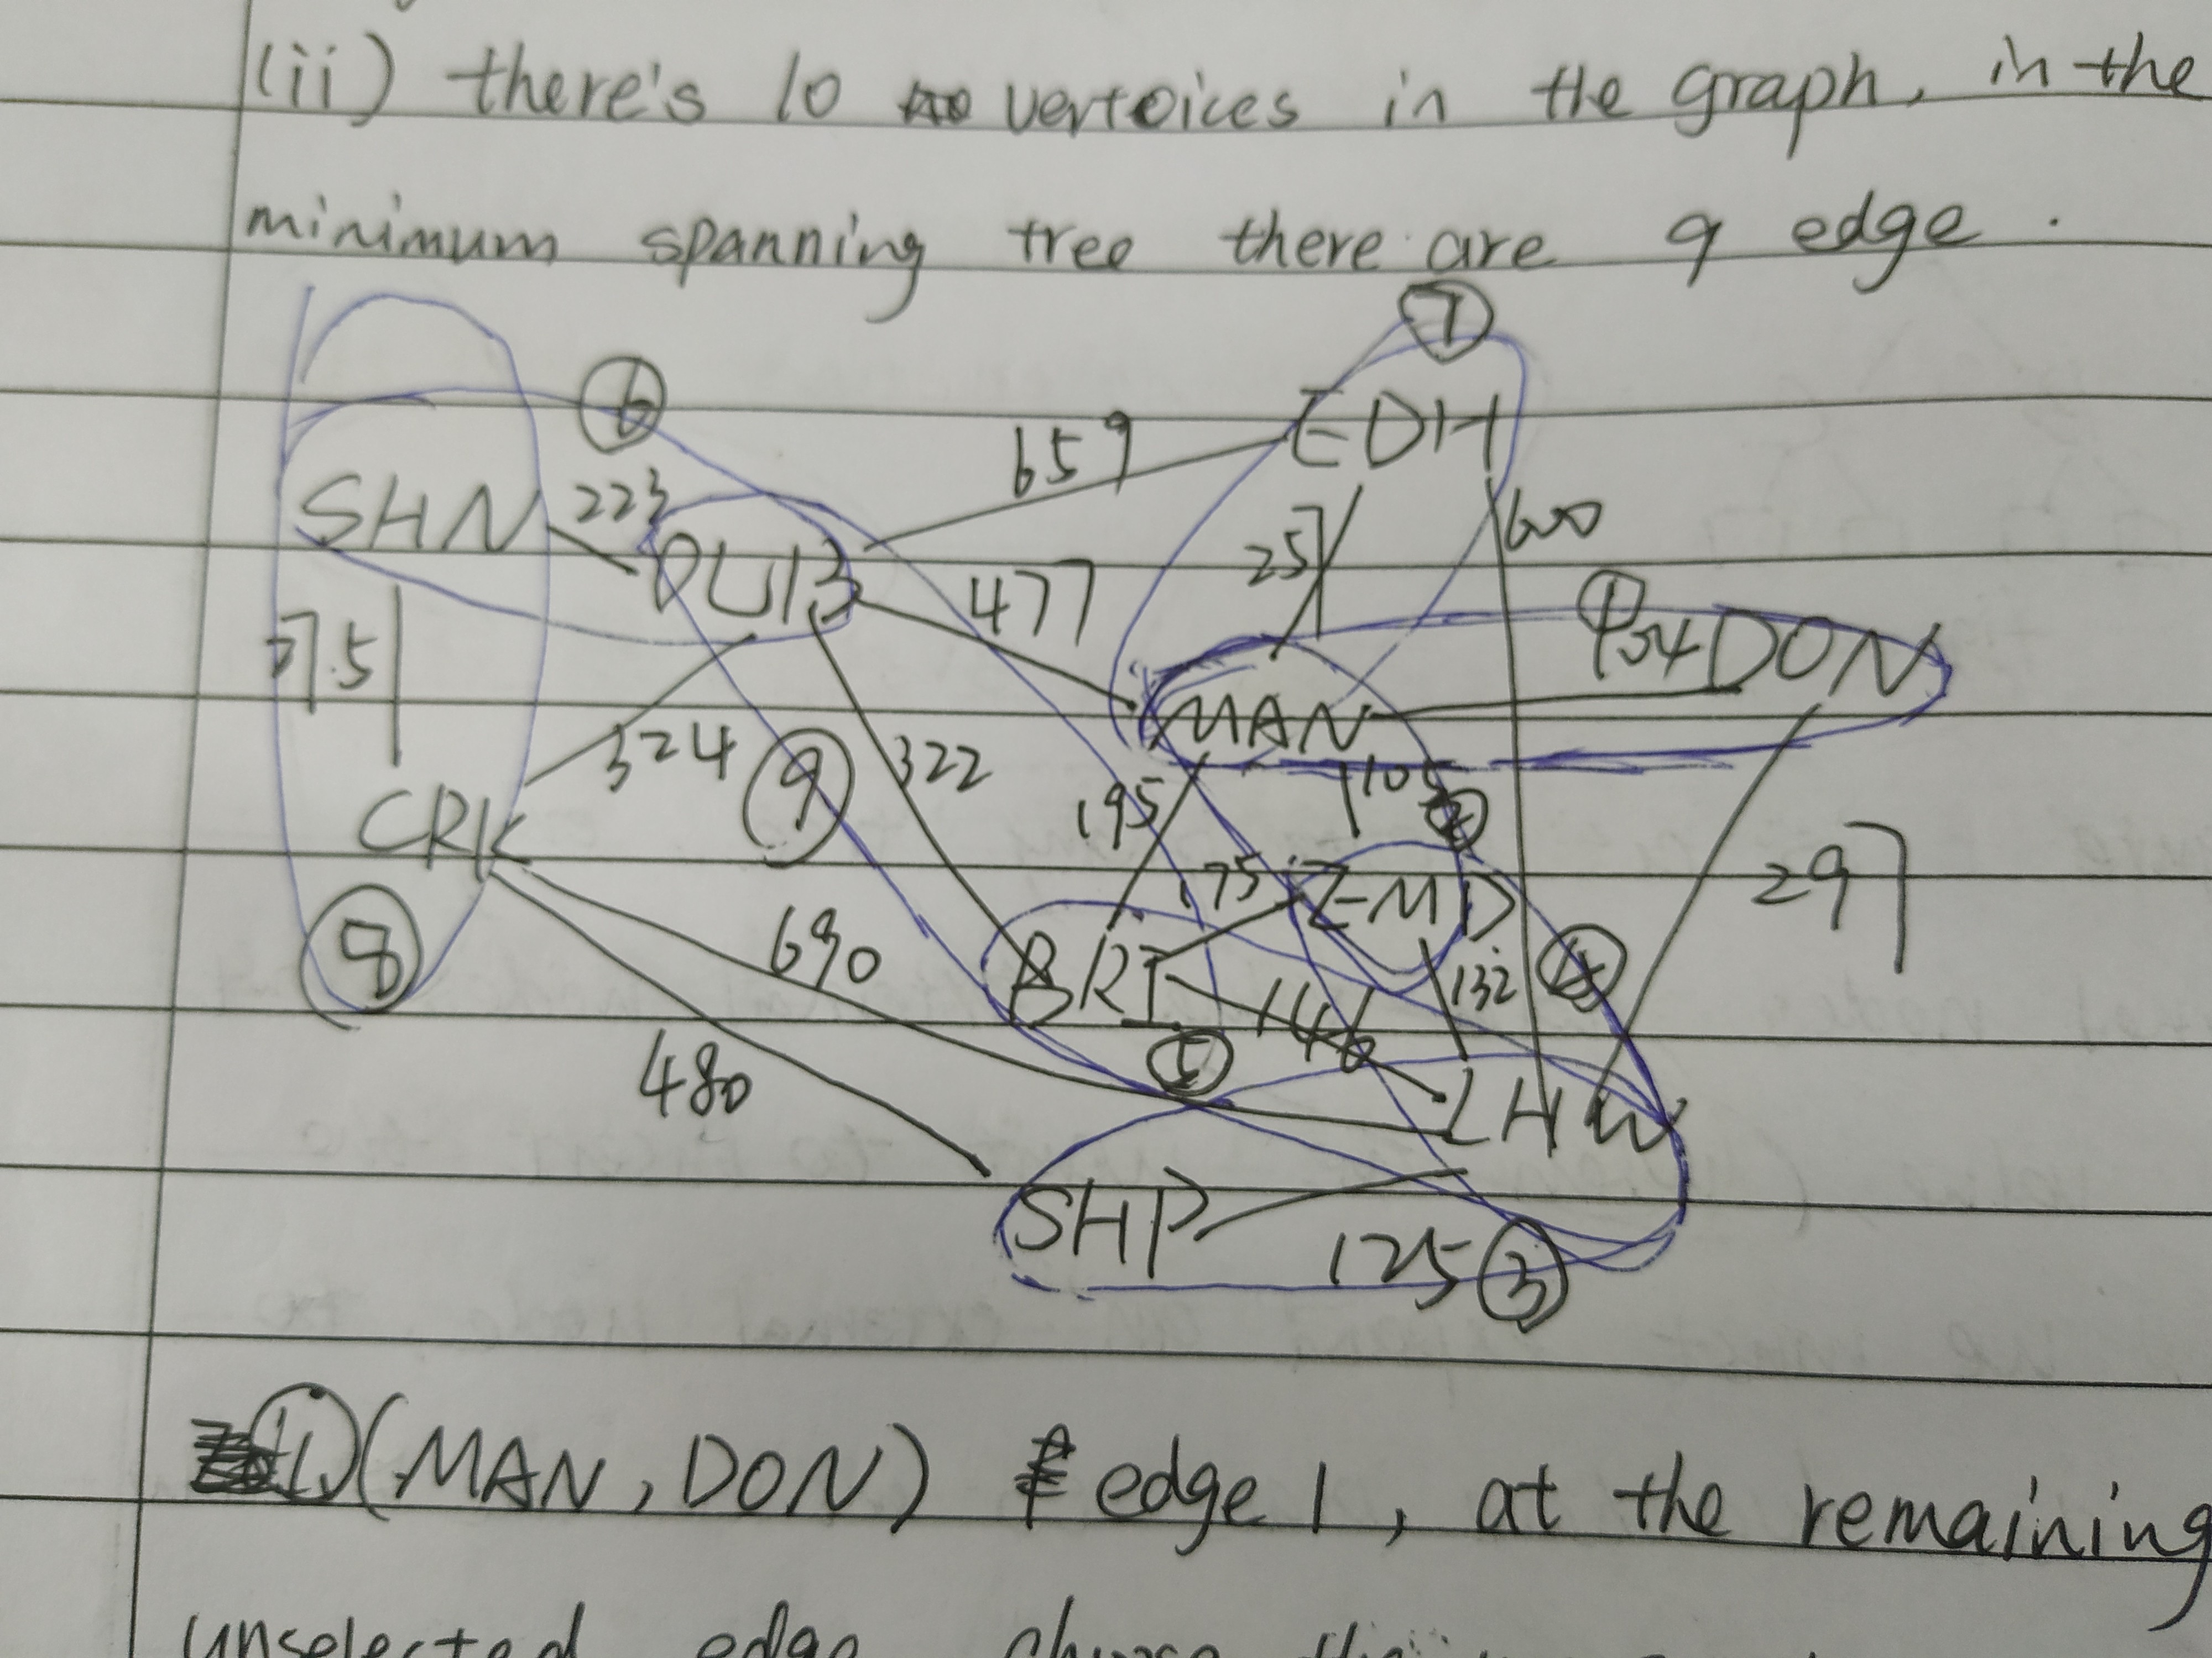

Slide 20
Exam Advice
Plan your time:
120 minute exam.
10 minutes to read the paper at the beginning, and plan which questions you will attempt.
10 minutes at the end to read your answers again and make sure you have answered everything as best you can.
Exam has 100 marks:
Approximately 1 minute per mark.
A 5-mark question should take about 5 minutes.
A 20-mark question should take about 20 minutes.

Slide 21
Exam Advice
If you have doubts about describing something in English, maybe a diagram/picture will help?
BUT: a diagram should ALWAYS be explained: a diagram with no explanation is not useful.
Read the paper before answering any questions. I will visit all the exam rooms during the first half hour of the exam. If you do not understand what a question is asking, you can ask me.

Slide 22
Exam Advice
Do not write on the exam paper: answer books will be provided.
During the exam, do not talk to anybody or communicate with other students. If you need me or an invilator to come to you, raise your hand.
If you need to borrow something from another student, you must ask an invigilator to get it for you.
Using phones in exams is banned, and is a serious offence.
Also, this is a "closed book" exam: you may not bring any notes or study material with you.
Good luck!

